Slide 1

Investigating NBA Free Throw Attempt Rate (1982-2022)
MAS 766 - Group 7
Preston Klaus, James Hyman, and Joey Deaton

Slide 2
Motivation
The goal of our project is to analyze Free Throw trends in the National Basketball Association (NBA)
Players have been criticized recently for “hunting fouls”, intentionally getting hit by a defender in order to shoot free throws
This season the NBA Competition Committee attempted to put an end to this type of action, and there has been a notable decrease in offensive output across the league

Slide 3
Motivation
An article that dives into year by year scoring trends was published in the Washington Post https://www.washingtonpost.com/sports/2021/11/04/nba-scoring-foul-hunting-free-throws/
The key findings were that points per game average is down 4 points compared to the last three seasons, and teams are taking around 3 less free throws per game
Many superstars are not happy with this change, with Trae Young of the Atlanta Hawks saying, “[there’s been] a lot of missed calls, guys are going to get hurt”

Slide 4
Data Description
Our data was scraped from Basketball Reference, and includes 40 years 1981-82 to 2021-22) of league average per game stats
There are 30 variables in the data set, such as field goal and three point percentage, defensive stats like steals and blocks, and even advanced statistics such as pace and offensive rating
There are two statistics that we are most interested in investigating, FTA (free throw attempts per game), and FTr (free throws attempted per possession, or free throw rate). The latter adjusts for what percentage of the total volume of a team’s shots are free throws, rather than being just a count statistic

Slide 5
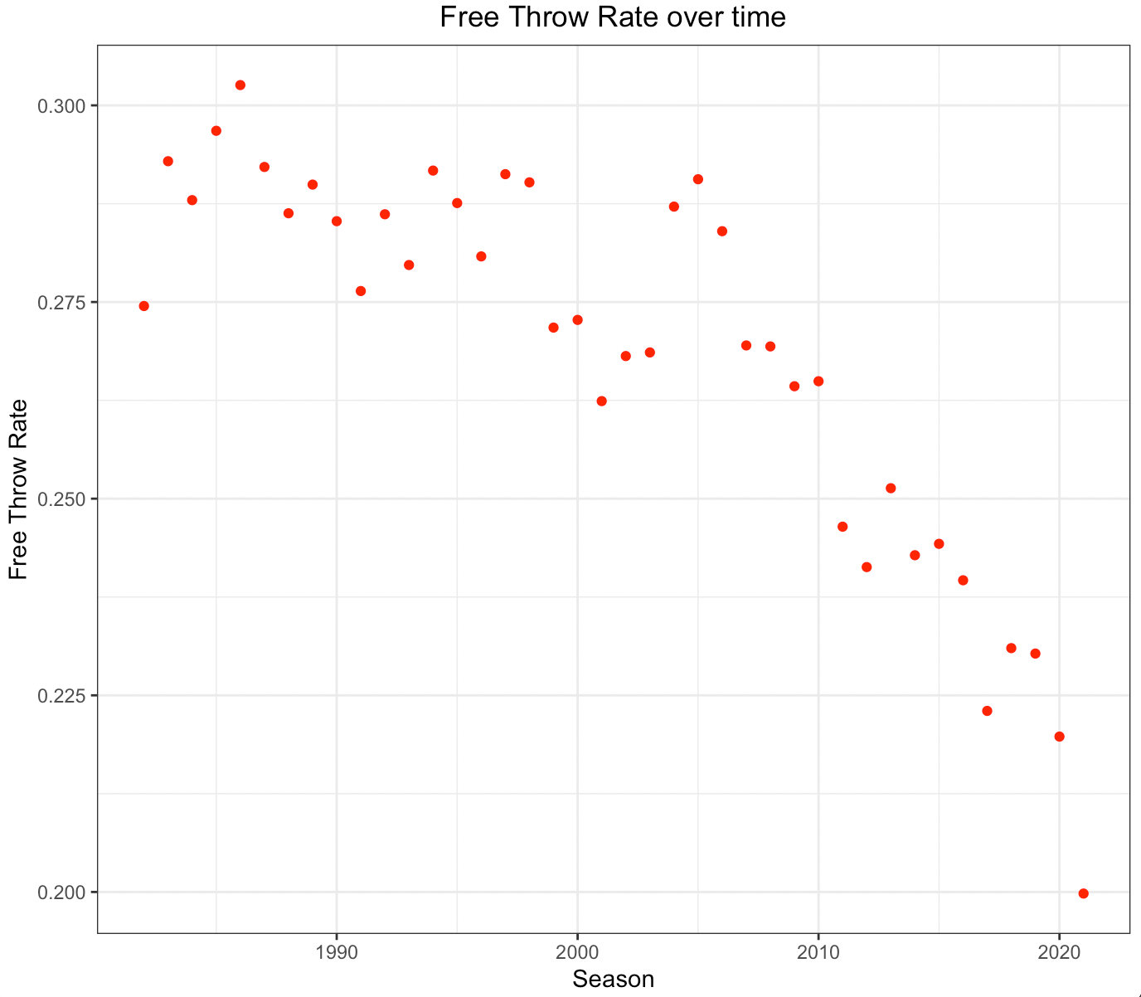
Data Description

Slide 6
Data Description
Summary statistics for FTr:
Min. | 1st Quartile | Median | Mean | 3rd Quartile | Max.
0.1998 | 0.2501 | 0.2736 | 0.2684 | 0.2877 | 0.3026

Slide 7
Model Selection
To model FTr, we will be doing a Time Series analysis to determine the overall trend of the variable, how its past values affect its future values, and the effect of other variables. We will do so in the following order:
Model 1
FTr vs. time period
Model 2
FTr vs. time period + lag value (1)
Model 3
FTr vs. time period + lag value(1) + other significant variables

Slide 8
Model Selection - Process
In order to select the best-performing model from our options, we will consider the following:
R² or Adjusted-R²
MSE
MAE
To evaluate MSE and MAE, we will test our model against the last four observations from our data (2019, 2020, 2021, 2022) While the model predicts the 35 seasons from 1984-2018 (1982-1983 season used for lag variable)

Slide 9
Model Assumptions
Linear Relationship between FTr and Time
Residuals are Normally Distributed
Equal Variance
Variables are Independent

Slide 10
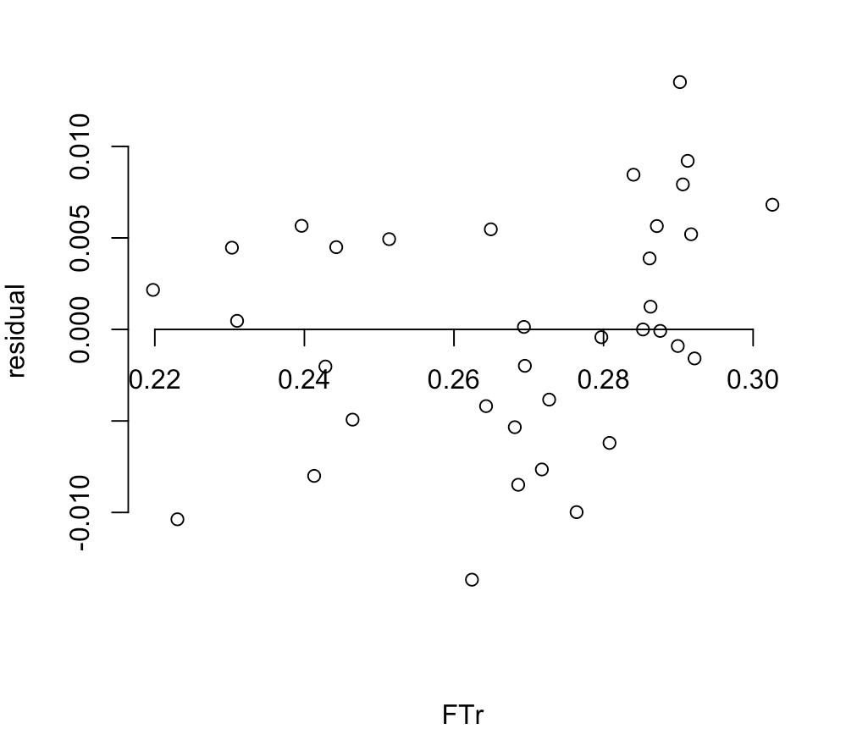
Residual Analysis
Residual Plot for Free Throw Rate

Slide 11
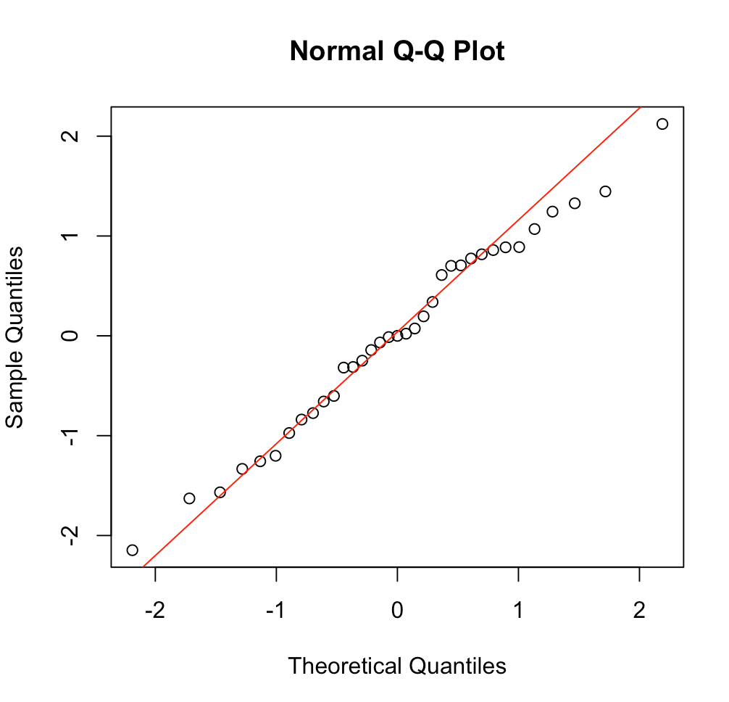
Residual Analysis

Slide 12
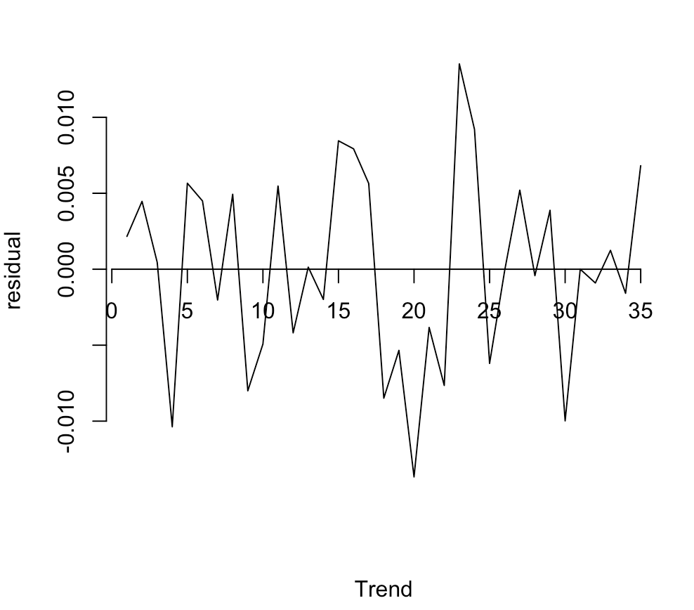
Residual Analysis
Residual Plot Time Trend

Slide 13
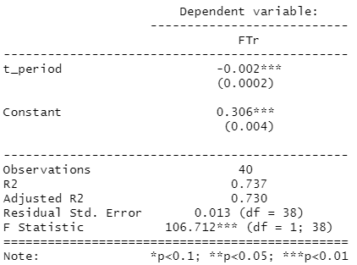
Model Selection - Model 1: FTr vs. time period
Trend has a significant negative effect
R² = 73.7%
MSE = 0.00353
MAE = 0.01541

Slide 14
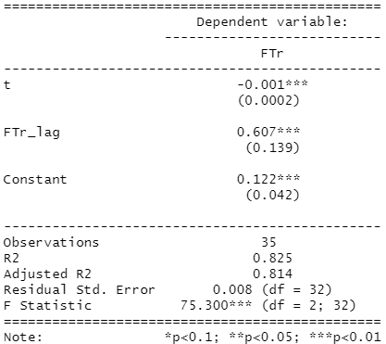
Model Selection - Model 2: FTr vs. time period + lag1
Trend has a significant negative effect
Lag variable has significant positive effect
Adjusted R² = 81.4%
MSE = 0.00017
MAE = 0.00984

Slide 15
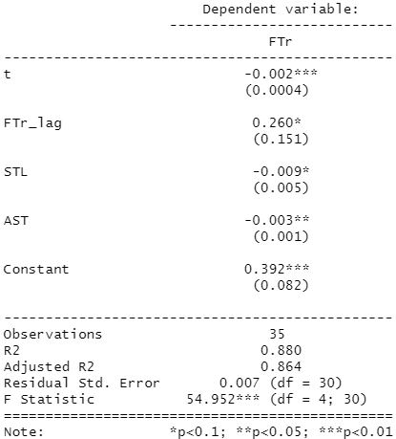
Model Selection - Model 3: FTr vs. time period + lag1 +
other significant variables
Trend has a significant negative effect
Lag variable has mildly significant positive effect
Steals has a mildly negative effect
Assists has a significant negative effect
Adjusted R² = 86.4%
MSE = 0.00009
MAE = 0.00883

Slide 16
Model Selection
Model 3 has highest R², lowest MSE, and lowest MAE
Thus, Model 3 will be selected as our final model
 | Model 1 | Model 2 | Model 3
MSE | 0.00353 | 0.00017 | 0.00009
MAE | 0.01541 | 0.00984 | 0.00883
R² (Adj if k>1) | 73.7% | 81.4% | 86.4%

Slide 17
Conclusion
Free throw rate is heavily influenced by the style of play in the NBA at any given time
This means that previous years as well as certain count statistics like steals and assists will be good indicators of current free throw rate
The largest error in prediction value was for the current 2022 season, so the decrease in foul calling is making free throw rate harder to predict
Since the 2021-22 season is only ¼ of the way through, this model would be improved by running it again at the end of the season for robust results
Including more advanced offensive metrics into the data set could also increase the accuracy

